Slide 1
An attempt to validate a possible slaveholder?
As documented by John Moore
April 21, 2022

Slide 2
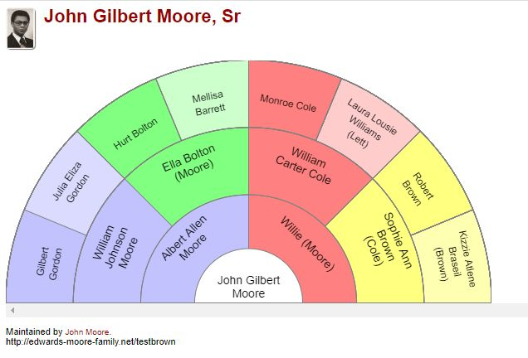
My eight Grandparents…

Slide 3
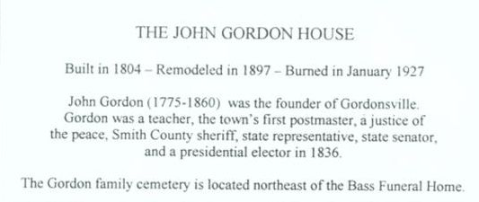
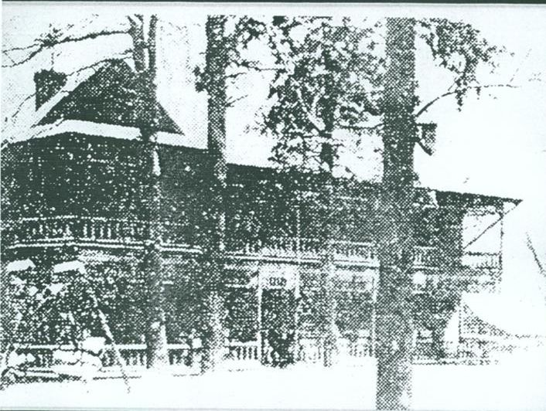
Early in April of 2022….
I received an email inquiring if I had found any more information on the Gordon possible slaveholder.
The question was prompted by my son running across story about the historic John Gordon house in Gordonsville, TN.
Oddly, I had! Two weeks ago, the results of my Ancestry DNA became available. I match DNA with people who have John Gordon , Francis and Thomas Haynes in their Ancestry Tree.

Slide 4
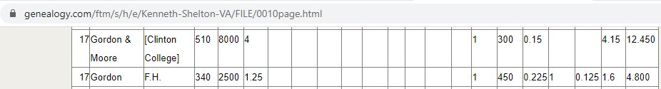
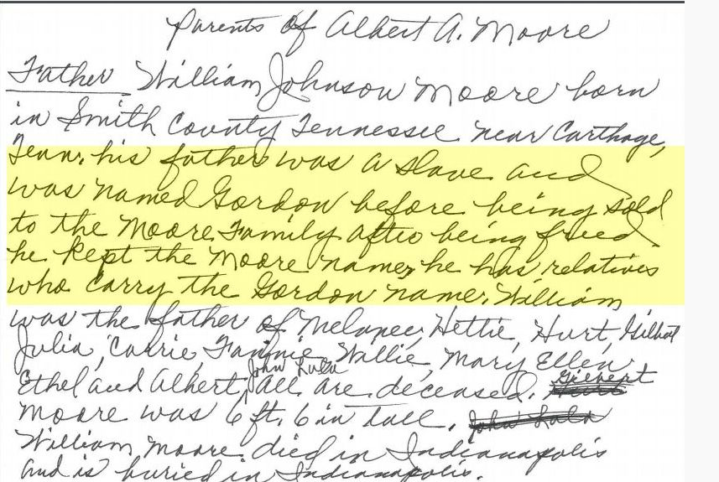
How it started…
In 2016 I ran across two Black men in Smith County, TN on the 1837 Poll Tax roll, named Moore and Gordon. What a coincidence. My Grandfather William Johnson Moore was born with the surname of Gordon. The Gordon surname is documented in our oral history and the name change in marriage records in 1886.

Slide 5
Using my grandparents as starting points I attempt to find our families last slave holders
Based on oral history and my grandfather’s death certificate, I know my Great Grandfather’s name was Gilbert Gordon who lived in Smith County TN. The connection to F. H. Gordon and John Gordon would need to be established prior to 1830 as the Poll Tax List was dated 1837. I want to identify individuals on the 1830 and 1840 slave schedules to bolster the assertion of the connection of Gilbert Gordon with F. H. Gordon listed on the 1837 Poll Tax List.
Noticing the coincidence of surnames on the Poll Tax list was not on the research plan, however attempting to identify the last slave holders of my great grandparents is the ultimate goal of recording our family history.

Slide 6
Why the 1837 Poll Tax list was of interest to me beyond names…
F. H. Gordon was involved in Clinton College, an agricultural school. My father was involved in agricultural education. He graduated from Tennessee A & I with a degree in Agriculture in 1934, during the WWII years worked as a “County Agent” in Tennessee, and during the post war years became the Agriculturist at Flanner House. It seems to be a connection with my father wanting to teach agriculture without the prospect of owning a farm.
Was my father aware of an ancestor being involved in agricultural education?

Slide 7
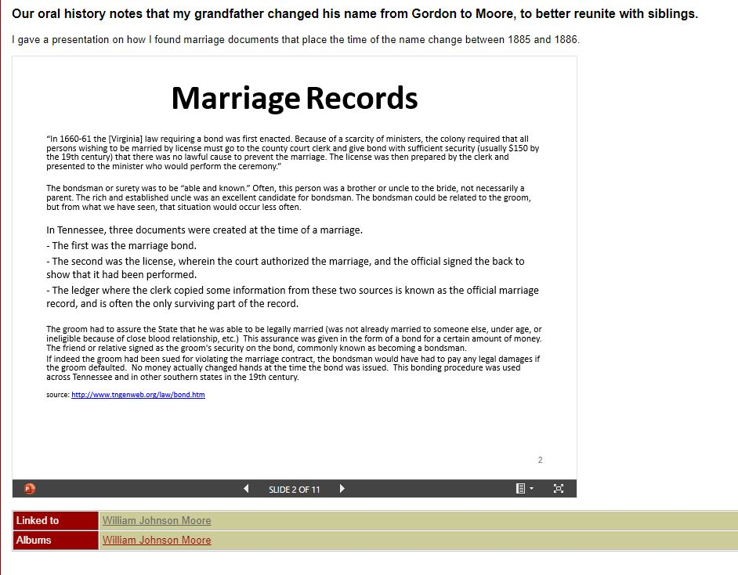
More background on the Surname change

Slide 8
Back to the eight Grandparents…..
I have the 1880 Federal Census Information for my 2xGF Gilbert Gordon. Some may recognize the custom of recycling names within the family. My middle name is Gilbert. The 1880 record places Gilbert’s birth in 1821 in Virginia.
I have the 1870 Federal Census record from Giles county for Gilbert Gordon, listed as a 25-year-old being born in Tennessee. The existence of Freedmens’s Bureau Outrage reports filed in Smith County in 1866 makes me question if the 1870 Census record is reliable for tracing my ancestors.
I have located 1870 census records for five of my eight grandparent surnames. Having 1870 census information is generally considered a good starting point for locating our ancestors last enslavers.

Slide 9
Research shared in August 2020 with the IAAGG Tennessee Study Group
The goal is to locate documentation on my grandfather who was born around 1852 in Smith County, TN. His last name was Gordon until he officially changed it to Moore in 1884. Below is how I searched for Gordon in Smith county, realizing his surname may not be the same as the slaveholder. I should complete this for “Moore” and look for the intersection of Gordon and Moore. I could also look in surrounding counties.
In Family Search I did a search for Gord*n in the United States, Tennessee. The results were.
I then restricted the collections to Slave Schedules (I also looked for 1870 and 1880 census to confirm William, Gilbert, and Gil Gordon records are found). The results were.
I then restricted locations to Smith county. Eight slave schedule records were found. Interestingly, Kyle Gordon who had 14 slaves (only 3 males over 2 years old), is listed on the same page as W. W. Moore who only had one slave, a 14-year-old male. To the point of the number of slaves typically held in Middle TN, Alice Gordon had 36 enslaved persons (“good” practice would suggest a female owner having more than ten enslaved would require an overseer).
The efforts of August 2020 demonstrated I continued to look for a connection. Having a point of reference in the 1830’s to the Gordon surnames adds to my confidence that the recent connection via DNA are the Gordon’s I’m looking for. I have sent messages to the five DNA matched individuals.
Link to meeting recording segment

Slide 10
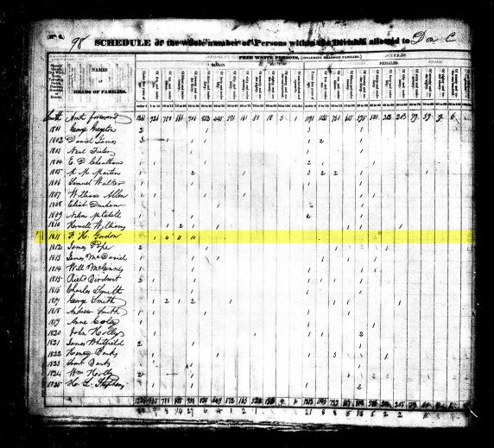
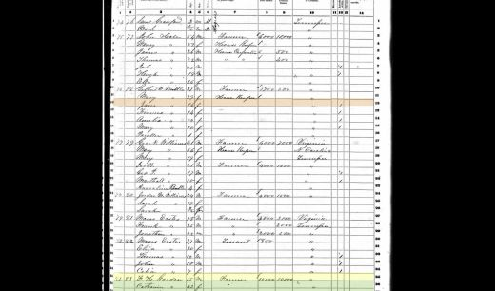
I will continue to search for documents

Slide 11
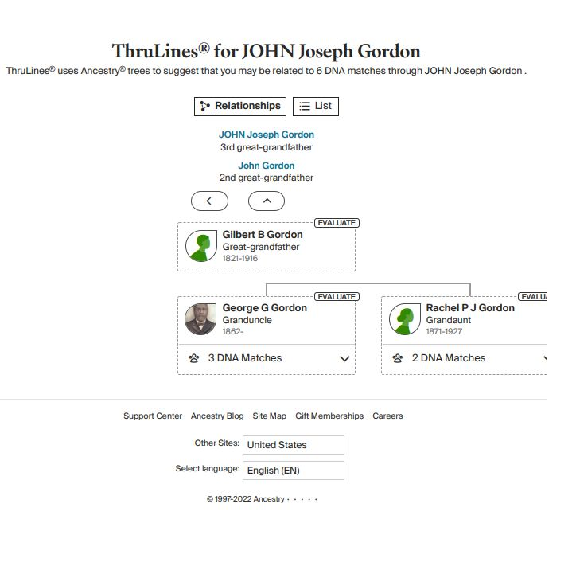
John Joseph Gordon Connection?

Slide 12
Quite a bit of work to do…

Slide 13
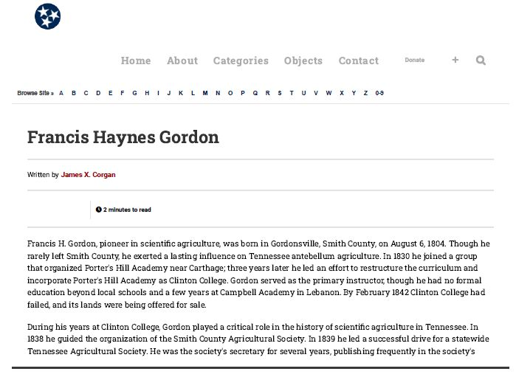
More research is needed…

